Slide 1


Vision-Based Virtual Keyboard
Supervisor: Eng. Abdelrahman Yahia
Members:
Mahmoud Ibrahim Tawfik
Mohamed Ahmed Elshoraky
Moaz Loaie Mohamed
Omar Alaa Zalat

Slide 2
Presentation Roadmap
Motivation & Problem Definition
Real-World Applications
Tools & Technologies
System Architecture
Functional Workflow
Design Logic
Demonstration
Conclusion

Slide 3
Why Build a Vision-Based Keyboard?
Touchless Demand
Physical Constraints
Post-COVID need for touchless interfaces.
Limitations of traditional keyboards.
Hygiene Issues
Gesture Input
Problems with touchscreen keyboards.
Computer vision enables hand movement typing.

Slide 4





Where Can This Be Used?
Accessibility
Hospitals & Labs
Kiosks
For motor disabilities.
Contactless input in sterile environments.
Airports, museums, public spaces.
Smart Homes
AR/VR Systems
Gesture control for devices.
Immersive interaction.

Slide 5
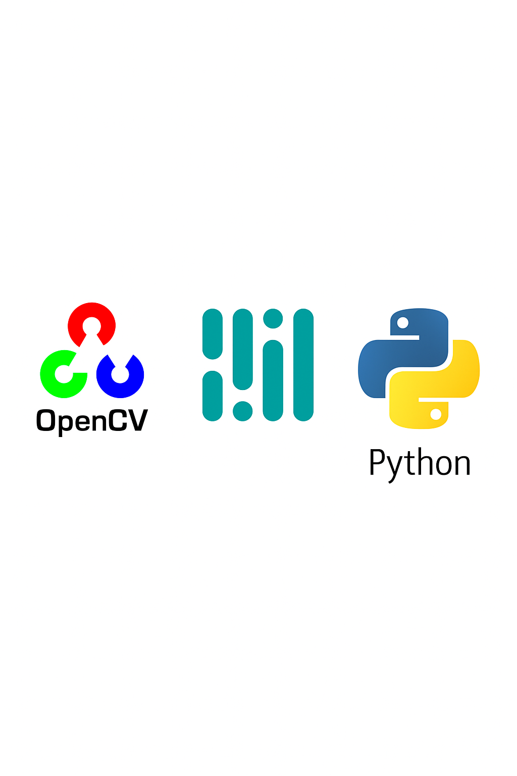
Tools and Frameworks Behind the Project
MediaPipe Hands
OpenCV
Python
Tracks hand landmarks
Webcam feed, UI rendering
Logic control
Gesture mapping
Real-time performance
Image processing

Slide 6

How the System is Structured
Capture Video
Webcam streams real-time frames
Detect Hands
MediaPipe finds hand & landmarks
Analyze Gesture
Index finger tracks gestures
Highlight Key
Virtual keyboard shows selected key

Slide 7
Step-by-Step Interaction Process
Hand Placement
In front of camera.
Landmark Detection
Starts tracking.
Fingertip Tracking
Across frames.
Key Matching
Finger position to key.
Confirm Selection
On gesture.
Visual Feedback
Shown.
Character Added
To text.

Slide 8
Why We Built It This Way
Manual UI Control
Simple Gestures
Fixed Layout
Keyboard drawn for full control.
Pinch/hold for keypress.
For consistency.
Hover Feedback
Delay Mechanism
Color highlights.
Avoids multiple presses.

Slide 9
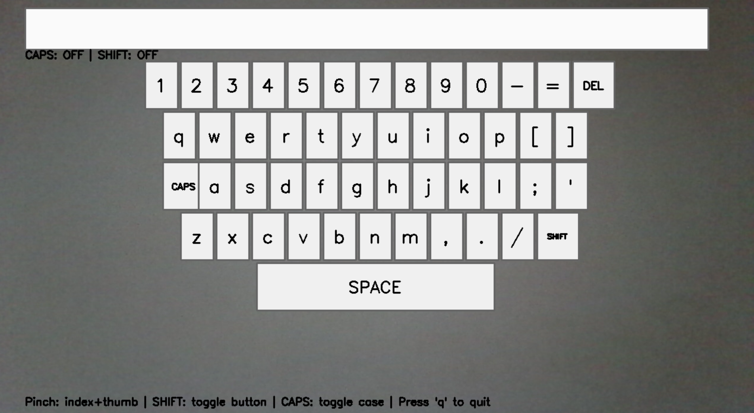
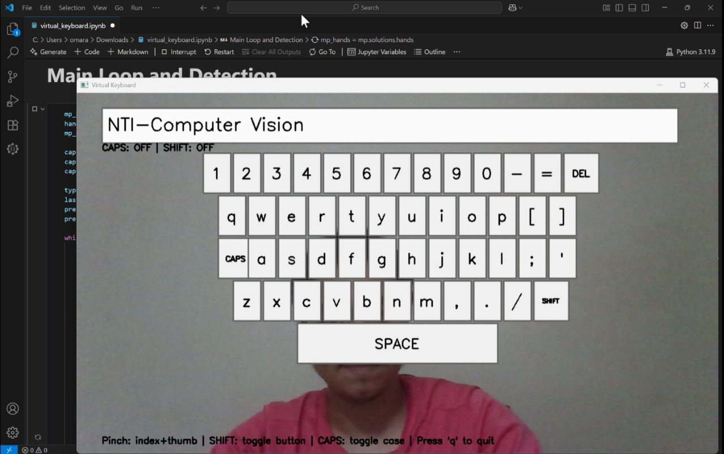
Demonstration

Slide 10
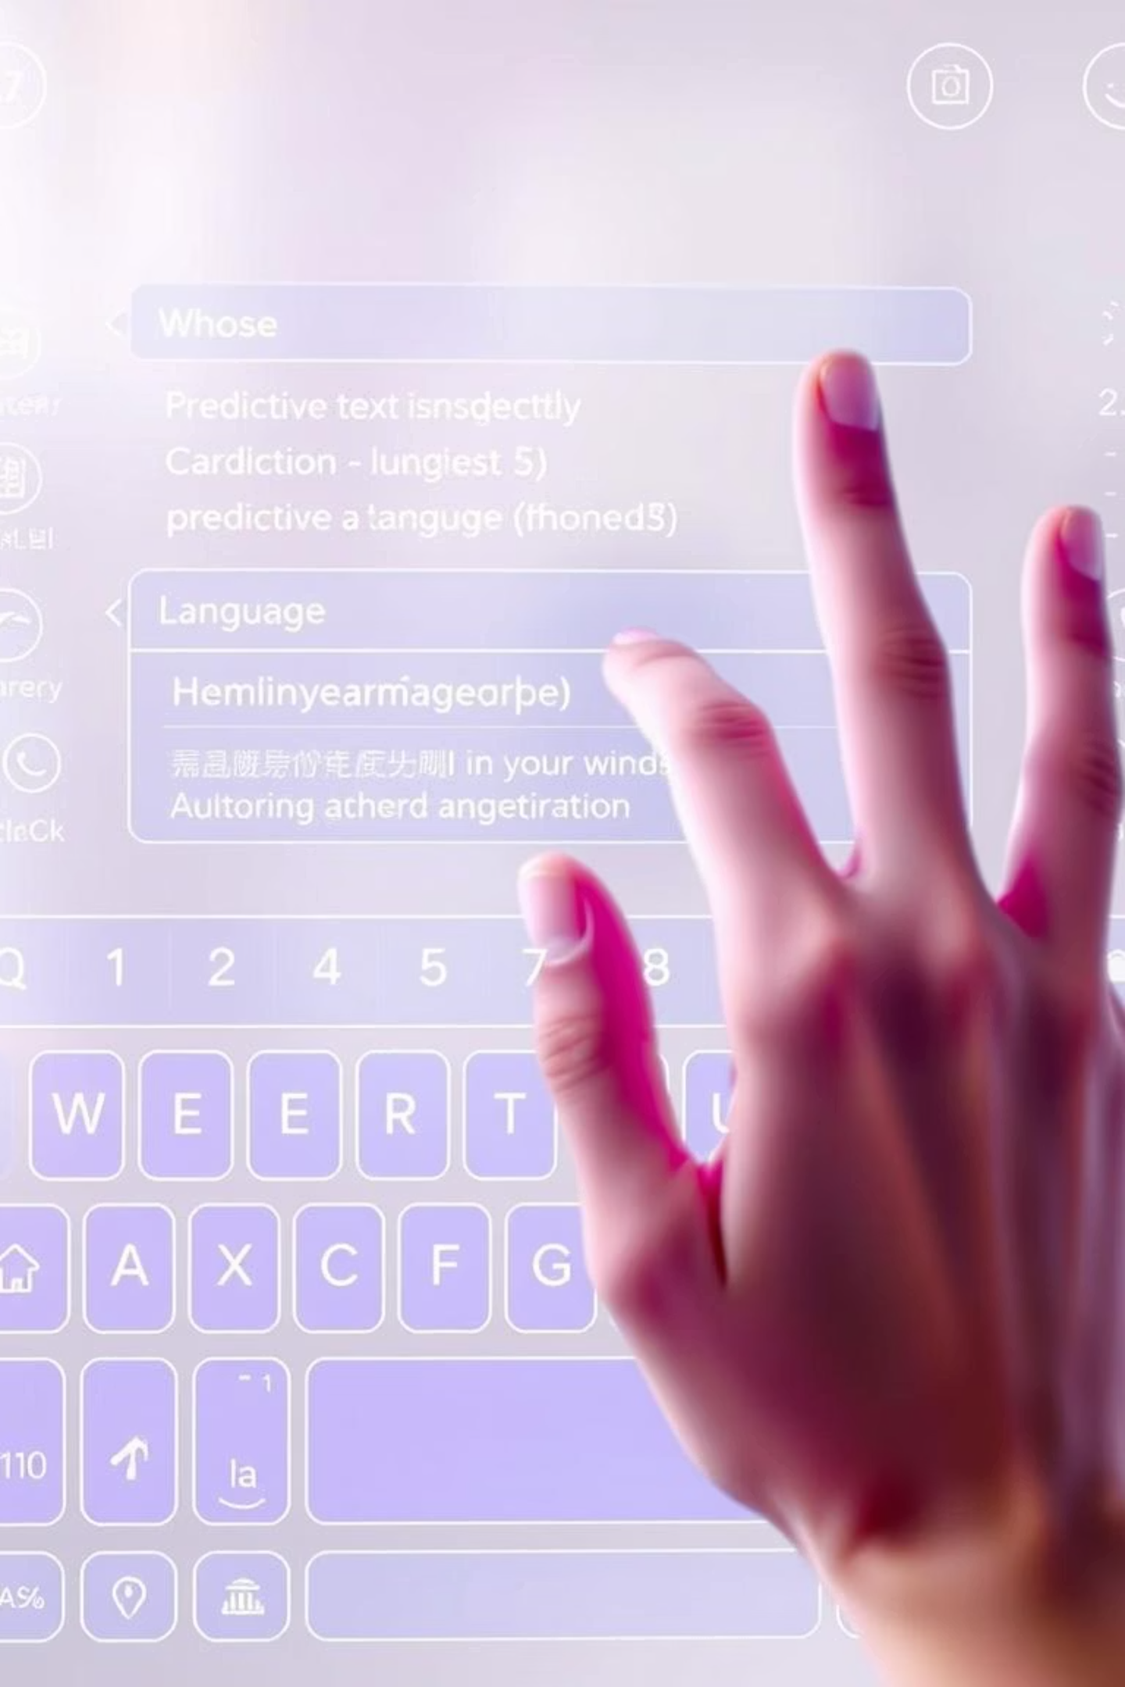
Conclusion
Touchless Typing using hand gestures
Real-time detection with MediaPipe & OpenCV
Custom virtual keyboard design
Foundation for gesture-based interfaces

Slide 11

ANY QUESTIONS?
You can find our project on GitHub: GitHub Repository

